Slide 1
OSC Vacuum System Layout for 0.65m and 0.85m mixed bends
CESR profile or round pipe
Flare for 15cm bypass
CESR profile or round pipe
2.6m
2.2m

Slide 2
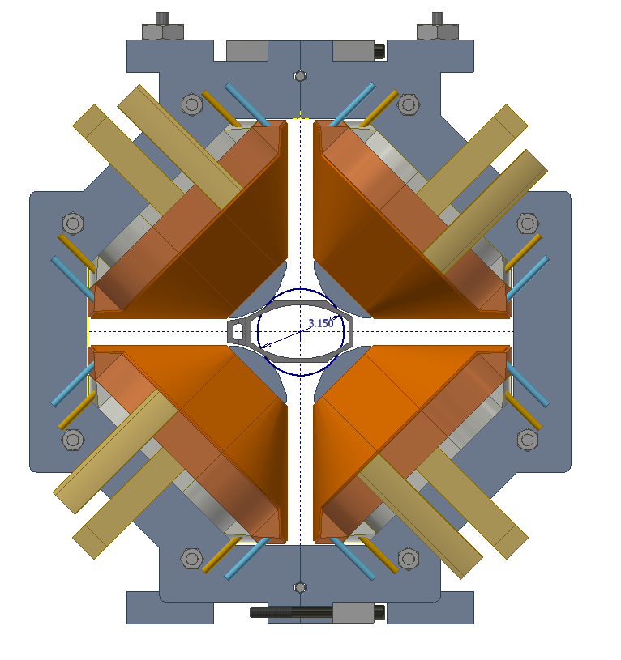
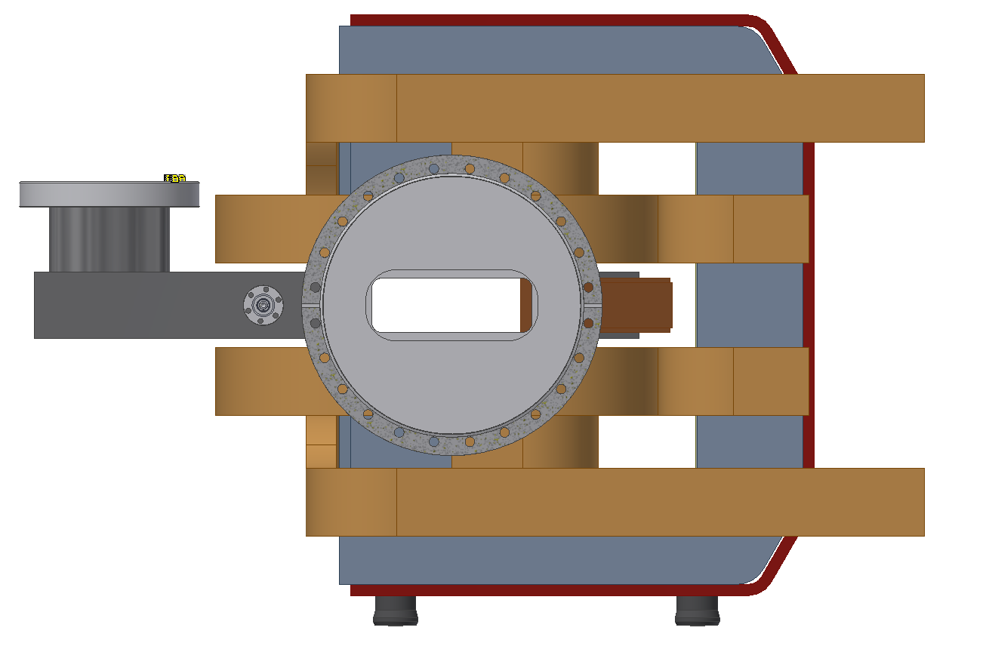
CESR profile or round pipe
Existing soft bends:
46mm x 135mm
CESR MKII:
Max 80mm OD
GV
Sliding joint
Transition
region
Transition region
& chamber for synch light

Slide 3
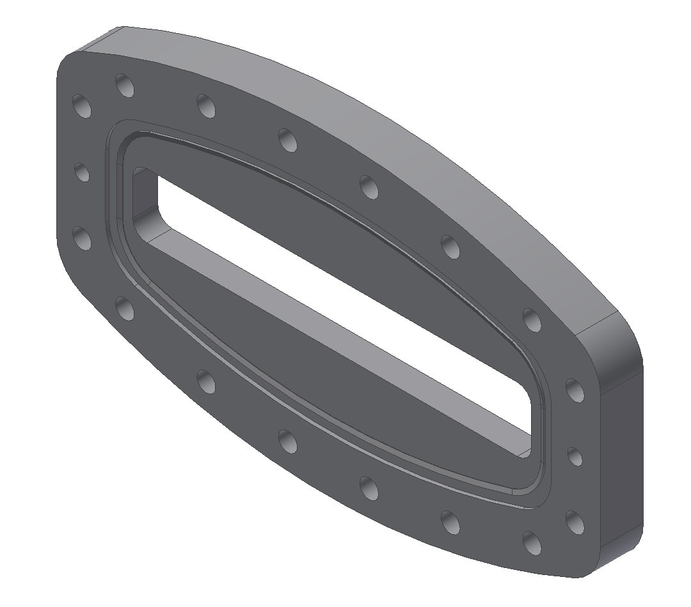
Flare for 15cm bypass
12 button bpm
Optics chamber
Optics chamber
Optics chamber

